Slide 1
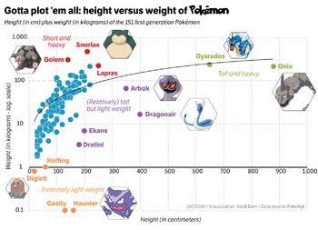
Beginner’s guide to ggplot2
Kirsten Isabel Verster

Slide 2
Itinerary
On the “grammar of graphics”
The syntax and elements of a ggplot2 object
Several practical examples

Slide 3
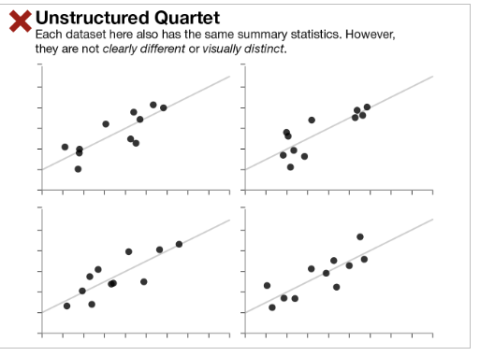
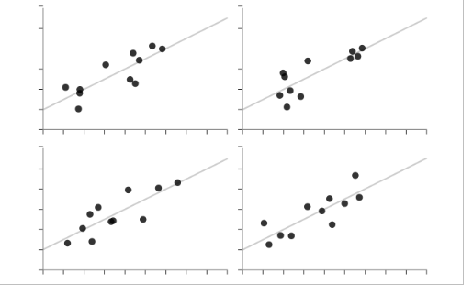

Slide 4
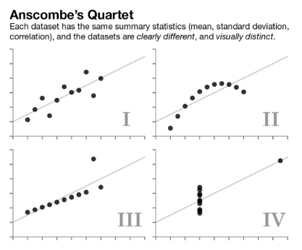
The importance of graphical representation
F.J. Anscombe in 1973
The effectiveness of Anscombe's Quartet is not due to simply having four different datasets which generate the same statistical properties, it is that four clearly different and visually distinct datasets are producing the same statistical properties.

Slide 5
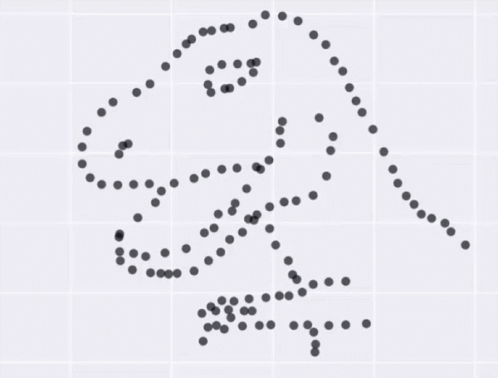
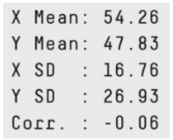
The Datasaurus Dozen
Alberto Cairo created the Datasaurus dataset which urges people to "never trust summary statistics alone; always visualize your data",
tinyurl.com/gg2022sssg

Slide 6
The Datasaurus Dozen
Matejka and Fitzmaurice made 200,000 incremental changes to the Datasaurus data set, slightly shifting points so that the summary statistics stayed within one-hundredth of the originals
Matejka explains why this is important in practice through what’s called Simpson’s Paradox, where groups of data within a set might show one trend, but the entire data set might show something completely contradictory. For example, Matejka points to one set of data that appears to show crime increasing. Yet when that data is broken down by location, there is a strong downward trend in crime in each area–another example of how data that has the same summary statistics can look vastly different when it’s graphed.
tinyurl.com/gg2022sssg

Slide 7
The Datasaurus Dozen
SUMMARY STATS are deceptive, make pretty pictures
tinyurl.com/gg2022sssg

Slide 8
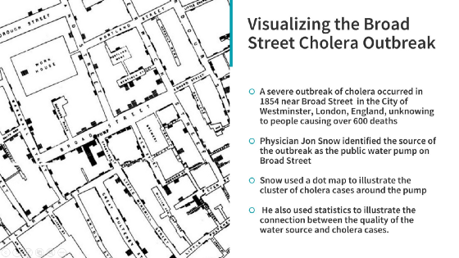
See notes
tinyurl.com/gg2022Sarkar
Notes:
physician John Snow's study of its causes and his hypothesis that germ-contaminated water was the source of cholera, rather than particles in the air (referred to as "miasma").[
ow later used a dot map to illustrate how cases of cholera occurred around this pump.^{[14]} Snow's efforts to connect the incidence of cholera with potential geographic sources was based on creating what is now known as a Voronoi diagram. He mapped the locations of individual water pumps and generated cells which represented all the points on his map which were closest to each pump. The section of Snow's map representing areas in the city where the closest available source of water was the Broad Street pump included the highest incidence of cholera cases. Snow also performed a statistical comparison between the Southwark and Vauxhall Waterworks Company, and a waterworks at Seething Wells (owned by the Lambeth Waterworks Company) that was further upriver and hence had cleaner water; he showed that houses supplied by the former had a cholera mortality rate 14 times that of those supplied by the latter.^{[15][16]}

Slide 9
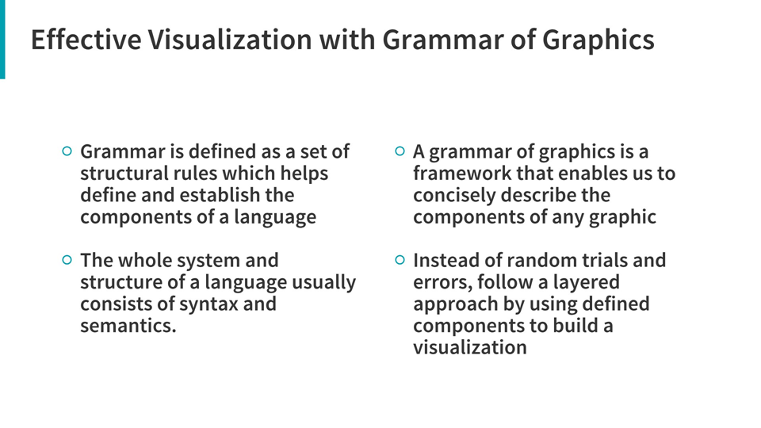
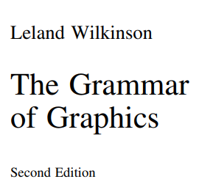
Which leads us to the GoG
tinyurl.com/gg2022gog
Notes:
First proposed by Leland Wilkinson

Slide 10
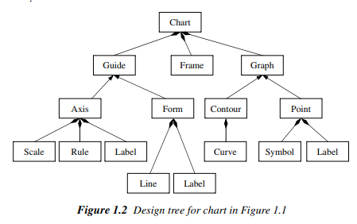
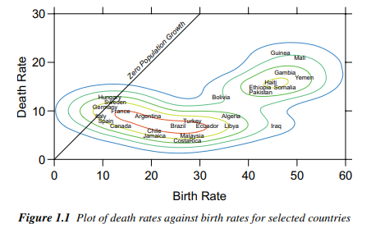
Object oriented graphics system
See notes
Notes:
A graph is a set of points. A mathematical graph cannot be seen. It is an abstraction. A graphic, however, is a physical representation of a graph. This representation is accomplished by realizing graphs with aesthetic attributes such as size or color. An object-oriented graphics system requires explicit definitions for these realizations and rules for relating them to data and for organizing their behavior in a computational environment. If we are lucky, this graphics system should have generality, yet will rest on a few simple objects and rules. This book is an attempt to reveal the richness of such a system. From the OOD perspective, graphics are collections of objects. If the messages between these objects follow a simple grammar, then they will behave consistently and flexibly. To introduce this idea, we will focus on three stages of graphic creation: 1) Specification 2) Assembly 3) Display After introducing these stages, we will show how they work in an example.
https://link.springer.com/content/pdf/10.1007%2F0-387-28695-0.pdf
But this wasn’t like actually a coding language YET

Slide 11
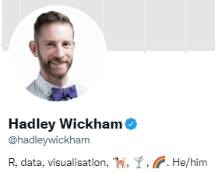
Which now takes us to ggplot2
ggplot2 is a powerful and a flexible R package, implemented by Hadley Wickham, for producing elegant graphics. The gg in ggplot2 means Grammar of Graphics, a graphic concept which describes plots by using a “grammar”.

Slide 12
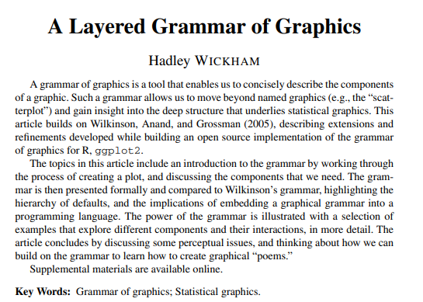
Which now takes us to ggplot2
ggplot2 is a powerful and a flexible R package, implemented by Hadley Wickham, for producing elegant graphics. The gg in ggplot2 means Grammar of Graphics, a graphic concept which describes plots by using a “grammar”.
tinyurl.com/gg2022layers

Slide 13
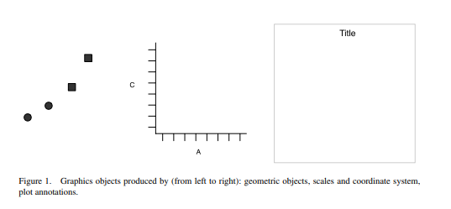
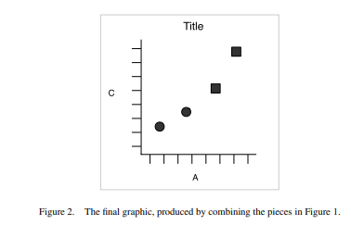
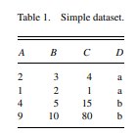
How to build a plot

Slide 14
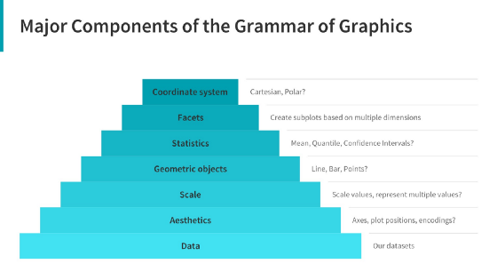
Components of the layered grammar
Data: Always start with the data, identify the dimensions you want to visualize.
Aesthetics: Confirm the axes based on the data dimensions, positions of various data points in the plot. Also check if any form of encoding is needed including size, shape, color and so on which are useful for plotting multiple data dimensions.
Scale: Do we need to scale the potential values, use a specific scale to represent multiple values or a range?
Geometric objects: These are popularly known as ‘geoms’. This would cover the way we would depict the data points on the visualization. Should it be points, bars, lines and so on?
Statistics: Do we need to show some statistical measures in the visualization like measures of central tendency, spread, confidence intervals?
Facets: Do we need to create subplots based on specific data dimensions?
Coordinate system: What kind of a coordinate system should the visualization be based on — should it be cartesian or polar?

Slide 15
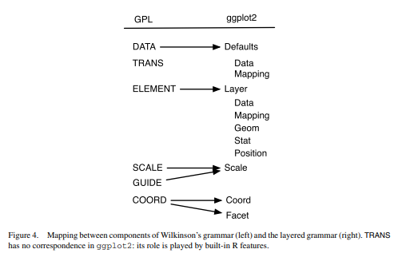

Slide 16
LAYERS
Layers are responsible for creating the objects that we perceive on the plot.
A layer is composed of four parts:
• data and aesthetic mapping
• a statistical transformation (stat),
• a geometric object (geom), and
• a position adjustment.

Slide 17
Layers are responsible for creating the objects that we perceive on the plot.
A layer is composed of four parts:
• data and aesthetic mapping = data are what turn an abstract graphic into concrete ; specification of which variables are mapped to aesthetics
• a statistical transformation (stat),
• a geometric object (geom) = controls the type of plot u want to make. E.g. point geom creates scatterplot, lime geom creates line plot (0d = point, txt; 1d = path, line; 2d = polygon, interval)
• a position adjustment = jiggle around, avoid overlaps

Slide 18
geoms
Geometric objects, or geoms for short, control the type of plot that you create. For example, using a point geom will create a scatterplot, whereas using a line geom will create a line plot. We can classify geoms by their dimensionality: • 0d: point, text, • 1d: path, line (ordered path), • 2d: polygon, interval. Geometric objects are an abstract component and can be rendered in different ways. Figure 6 illustrates four possible renderings of the interval geom. Geoms are mostly general purpose, but do require certain outputs from a statistic. For example, the boxplot geom requires the position of the upper and lower fences, upper and lower hinges, the middle bar, and the outliers. Any statistic used with the boxplot needs to provide these values.

Slide 19
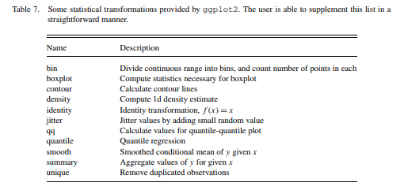
STATs =stat transformations

Slide 20
Sometimes we need to tweak the position of the geometric elements on the plot, when otherwise they would obscure each other. This is most common in bar plots, where we stack or dodge (place side-by-side) the bars to avoid overlaps. In scatterplots with few unique x and y values, we sometimes randomly jitter (Chambers et al. 1983) the points to reduce overplotting. Wilkinson called these collision modifiers.

Slide 21
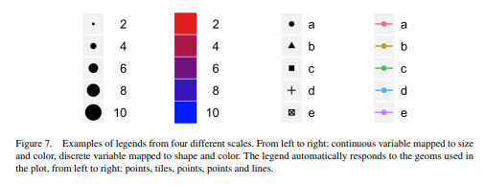
Scales
A scale controls the mapping from data to aesthetic attributes, and so we need one scale for each aesthetic property used in a layer. Scales are common across layers to ensure a consistent mapping from data to aesthetics. The legends associated with some scales are illustrated in Figure 7. A scale is a function, and its inverse, along with a set of parameters. For example, the color gradient scale maps a segment of the real line to a path through a color space. The

Slide 22
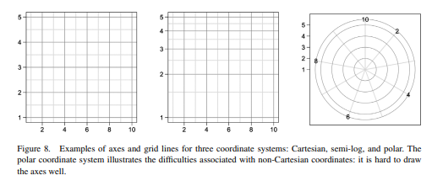
Coord()
Notes:
A coordinate system, coord for short, maps the position of objects onto the plane of the plot. Position is often specified by two coordinates (x, y), but could be any number of coordinates. The Cartesian coordinate system is the most common coordinate system for two dimensions, whereas polar coordinates and various map projections are used less frequently. For higher dimensions, we have parallel coordinates (a projective geometry), mosaic plots (a hierarchical coordinate system), and linear projections onto the plane.

Slide 23
Pulling them all together
Ggplot() creates a new plot object in the existing R language
Then add a single layer, specifying the data, mapping, geom & stat, position scales, and coord systems
Any aesthetics specified in the layer will override defaults
Shorthand
Notes:
Pg 15 from Wickham

Slide 24
Go thru script showing basic types of graphs
Starting with scatter plots and LOTS of iterations
Lots of histogram iterations
Boxplot
Colorblind friendly graphs

Slide 25
Maybe add
Pie chart?

Slide 26
Some helpful links
https://rafalab.github.io/dsbook/ggplot2.html
https://towardsdatascience.com/a-comprehensive-guide-to-the-grammar-of-graphics-for-effective-visualization-of-multi-dimensional-1f92b4ed4149
http://r-statistics.co/Top50-Ggplot2-Visualizations-MasterList-R-Code.html

